Slide 1











ATAI
Advanced Techniqueof Artificial Intelligence
ATAI
ChongqingUniversity _{AdvancedTechniqueof}
of Technology Artificial Intelligence
Chongqing University of
Technology
Chongqing University ^{ATAI}
_{of Technology} Advanced Techniqueof
Artificial Intelligence
Chongqing University of Technology
Chongqing University of Technology
NILC: Discovering New Intents with LLM-assisted Clustering
Code: https://github.com/HKBU-LAGAS/NILC
2026.01.07 •ChongQing
—— WSDM_2026
Reported by Shiyan Wu
1

Slide 2

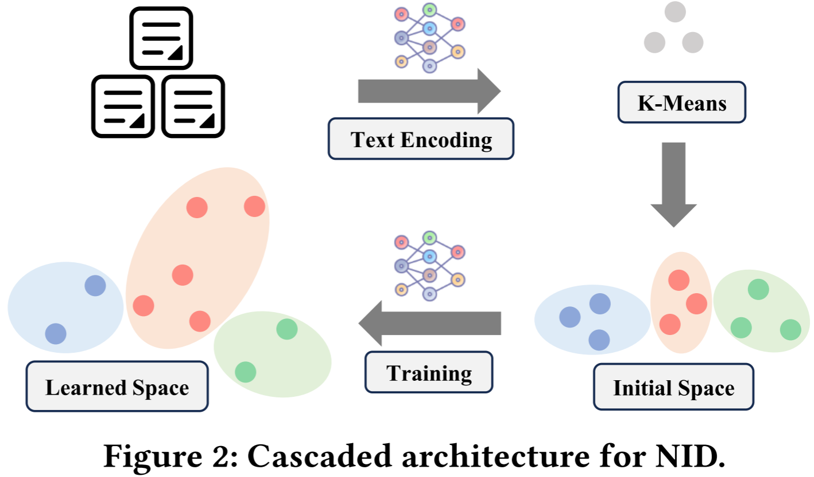
ATAI
AdvancedTechniqueof
Artificial Intelligence
ATAI
ChongqingUniversity _{AdvancedTechniqueof}
of Technology Artificial Intelligence
ChongqingUniversity of Technology
Motivation
1) The traditional cascade architecture suffers from a splitting step, that is, the information found in the clustering stage cannot be fed back to the encoding stage to correct the bias.
2) However, most existing vectors (such as BERT) lack reasoning capabilities and have difficulty capturing the deep intentions in ambiguous semantics or professional terms.
3) The traditional "LLM+ clustering" schemes either have excessively high full-scale generation costs or adopt overly static combination methods, lacking in-depth reasoning and integration.

Slide 3

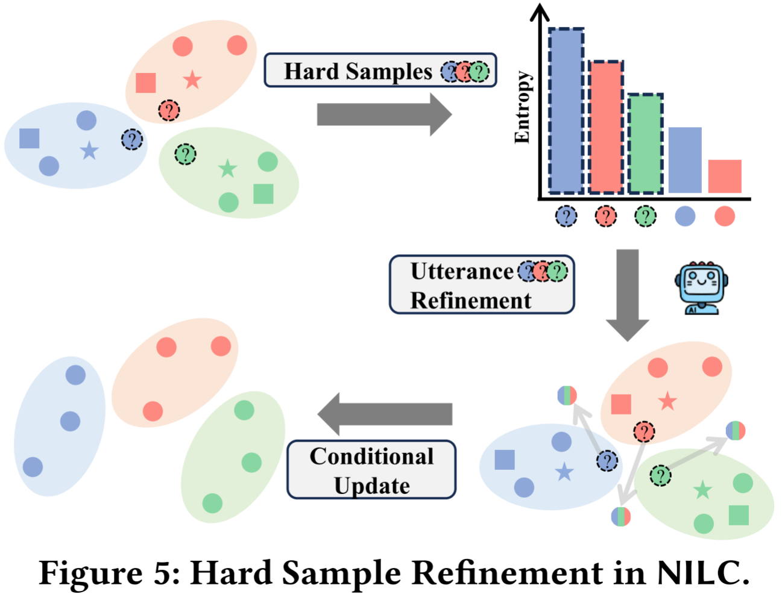
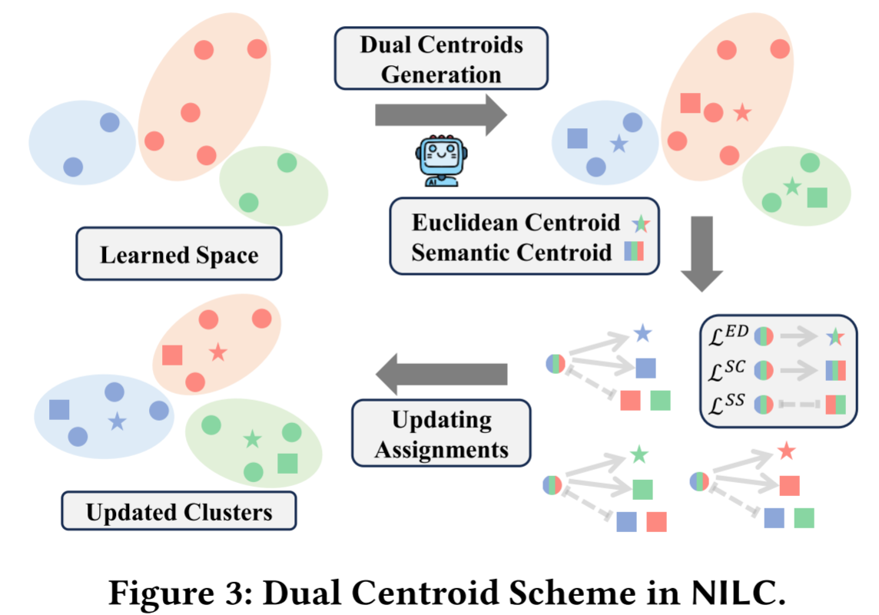

ChongqingUniversity of Technology
ATAI
AdvancedTechniqueof
Artificial Intelligence
ATAI
ChongqingUniversity _{AdvancedTechniqueof}
of Technology Artificial Intelligence
Overview

Slide 4
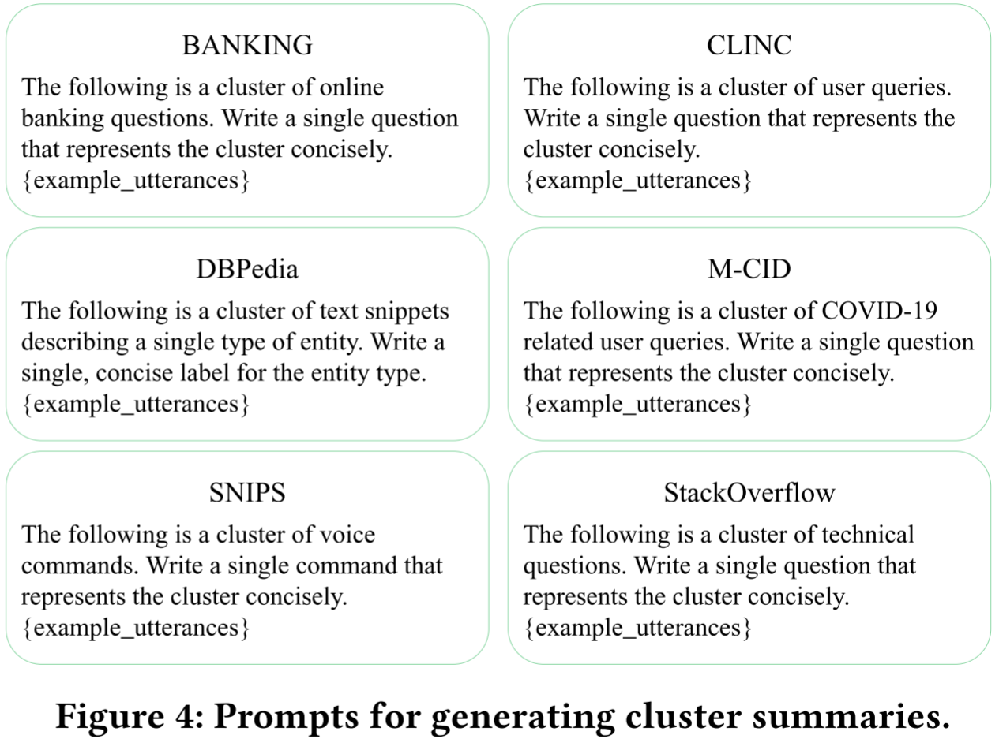
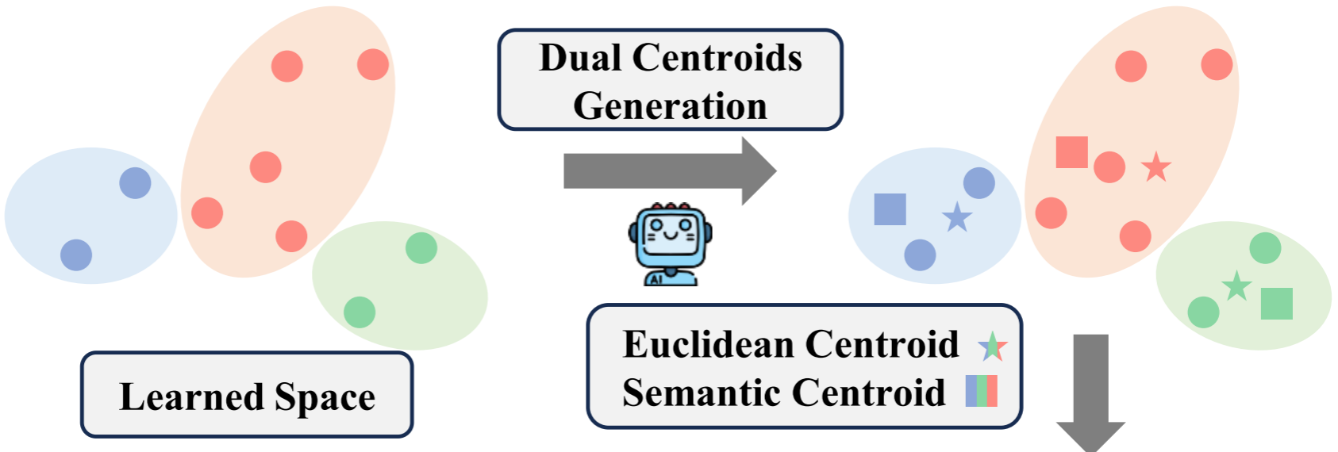
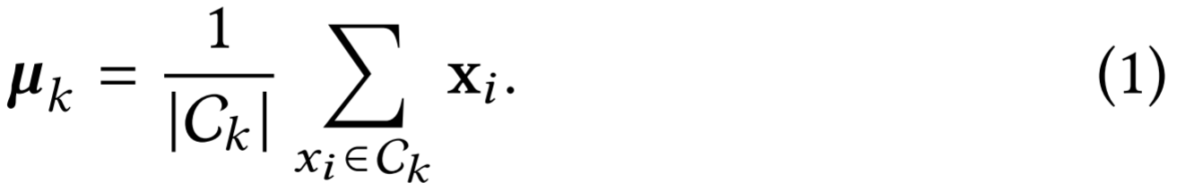
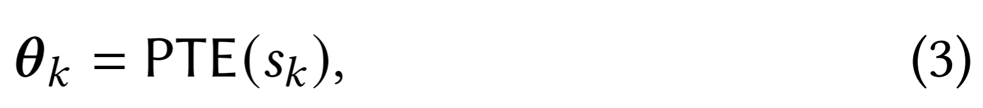
ChongqingUniversity of Technology
ATAI
AdvancedTechniqueof
Artificial Intelligence
ATAI
ChongqingUniversity _{AdvancedTechniqueof}
of Technology Artificial Intelligence
Method

Slide 5
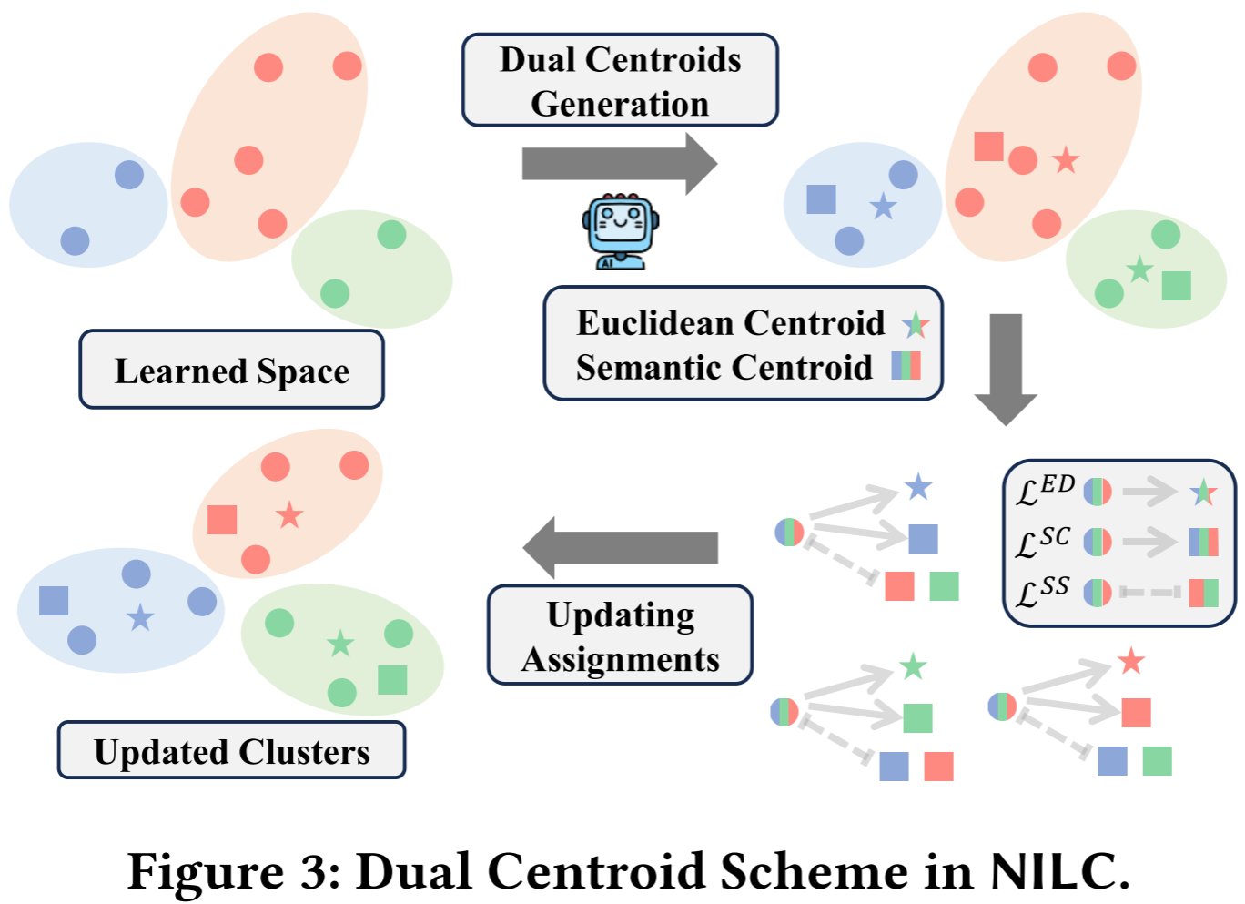
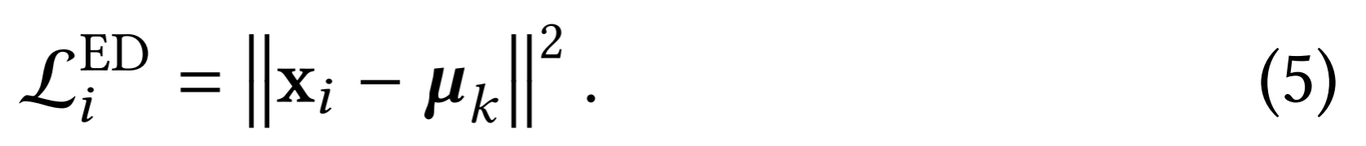
ChongqingUniversity of Technology
ATAI
AdvancedTechniqueof
Artificial Intelligence
ATAI
ChongqingUniversity _{AdvancedTechniqueof}
of Technology Artificial Intelligence
Method

Slide 6

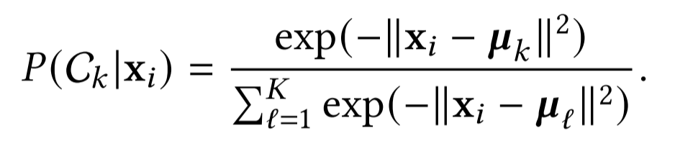
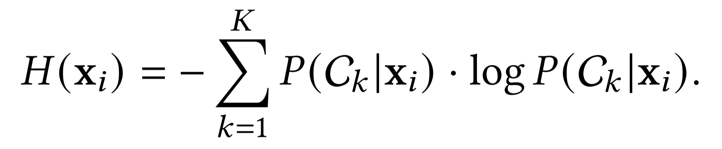
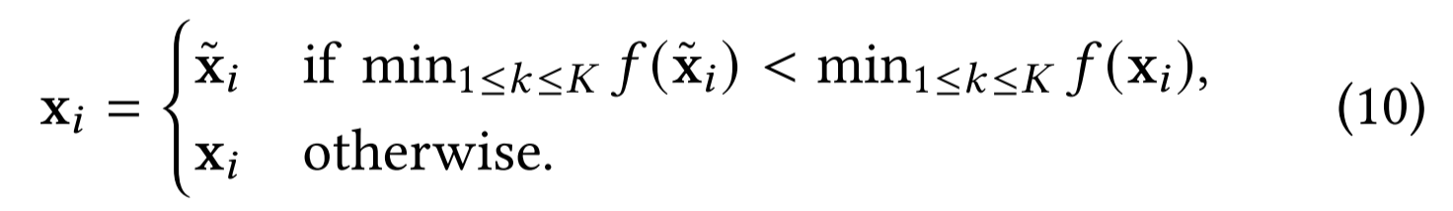
ChongqingUniversity of Technology
ATAI
AdvancedTechniqueof
Artificial Intelligence
ATAI
ChongqingUniversity _{AdvancedTechniqueof}
of Technology Artificial Intelligence
Method
(8)

Slide 7

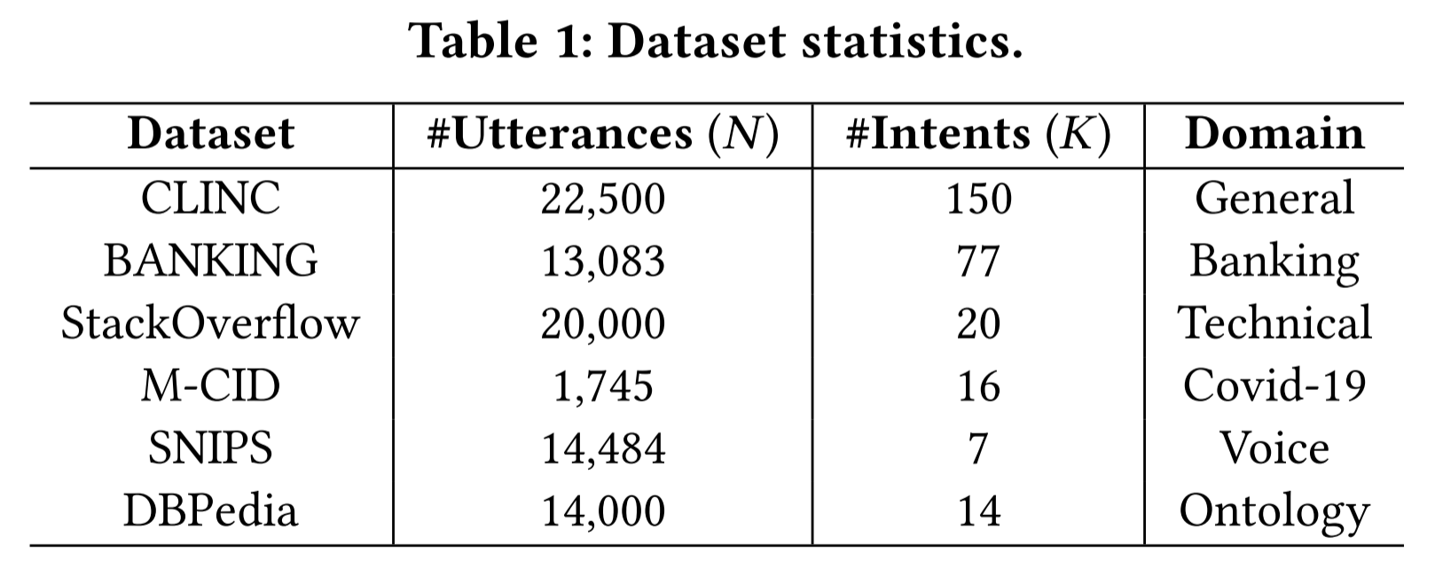
ATAI
AdvancedTechniqueof
Artificial Intelligence
ATAI
ChongqingUniversity _{AdvancedTechniqueof}
of Technology Artificial Intelligence
ChongqingUniversity of Technology
Experiments

Slide 8
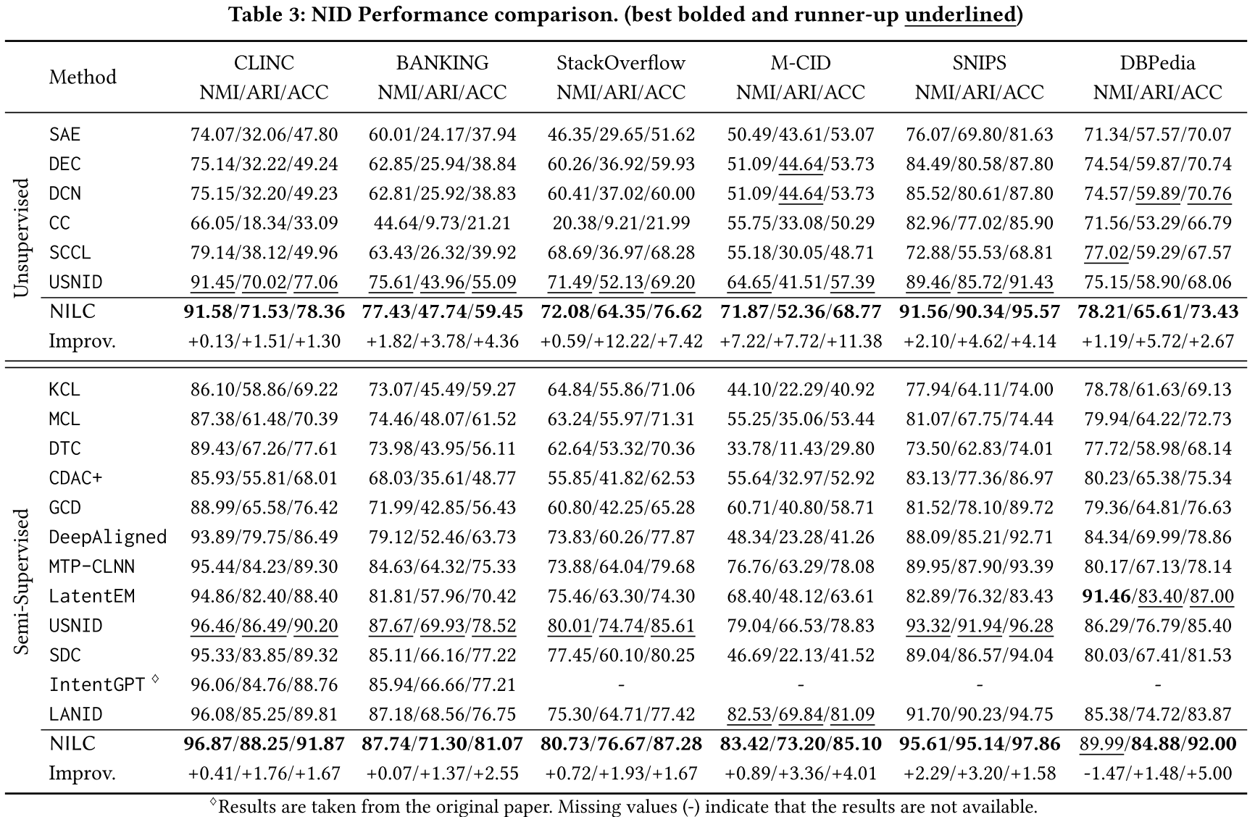
ATAI
AdvancedTechniqueof
Artificial Intelligence
ATAI
ChongqingUniversity _{AdvancedTechniqueof}
of Technology Artificial Intelligence
ChongqingUniversity of Technology
Experiments

Slide 9
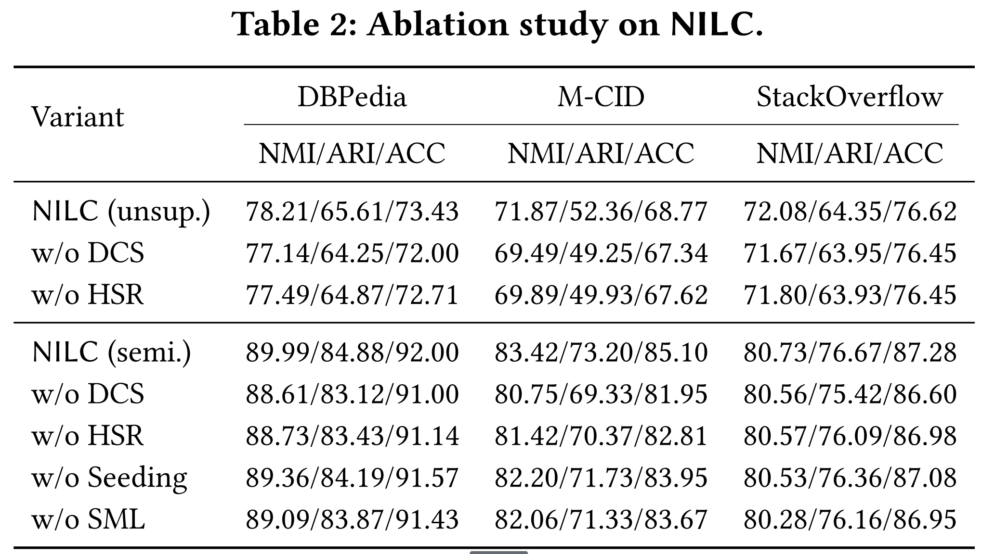
ATAI
AdvancedTechniqueof
Artificial Intelligence
ATAI
ChongqingUniversity _{AdvancedTechniqueof}
of Technology Artificial Intelligence
ChongqingUniversity of Technology
Experiments

Slide 10
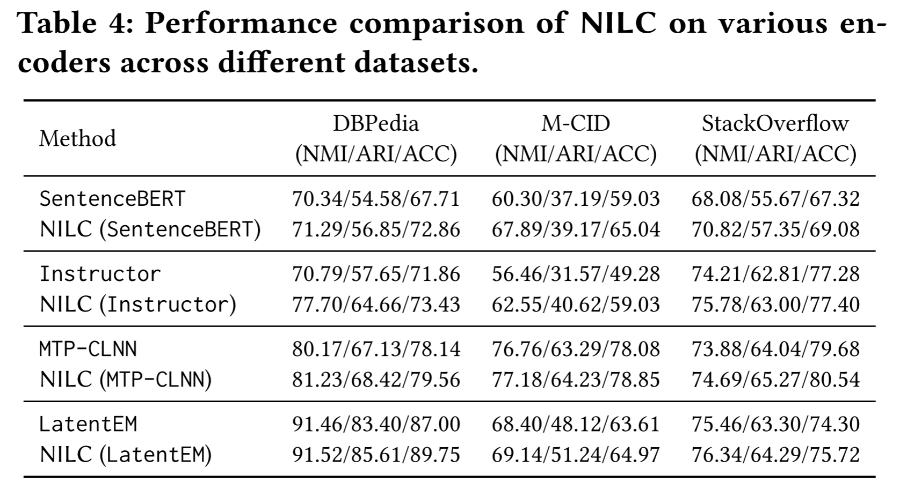
ATAI
AdvancedTechniqueof
Artificial Intelligence
ATAI
ChongqingUniversity _{AdvancedTechniqueof}
of Technology Artificial Intelligence
ChongqingUniversity of Technology
Experiments

Slide 11
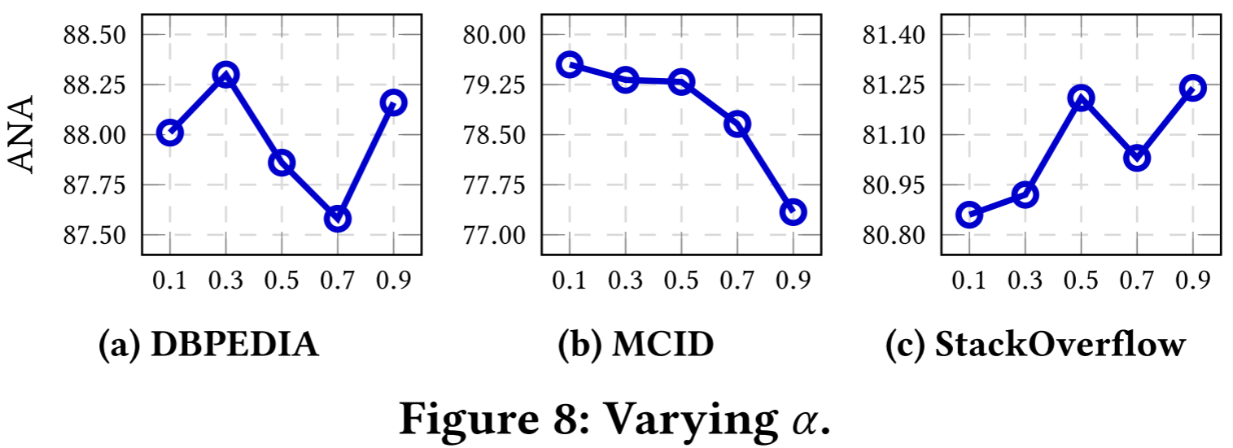
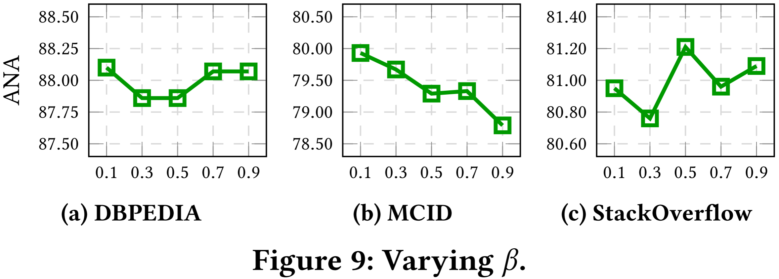
ATAI
AdvancedTechniqueof
Artificial Intelligence
ATAI
ChongqingUniversity _{AdvancedTechniqueof}
of Technology Artificial Intelligence
ChongqingUniversity of Technology
Experiments

Slide 12
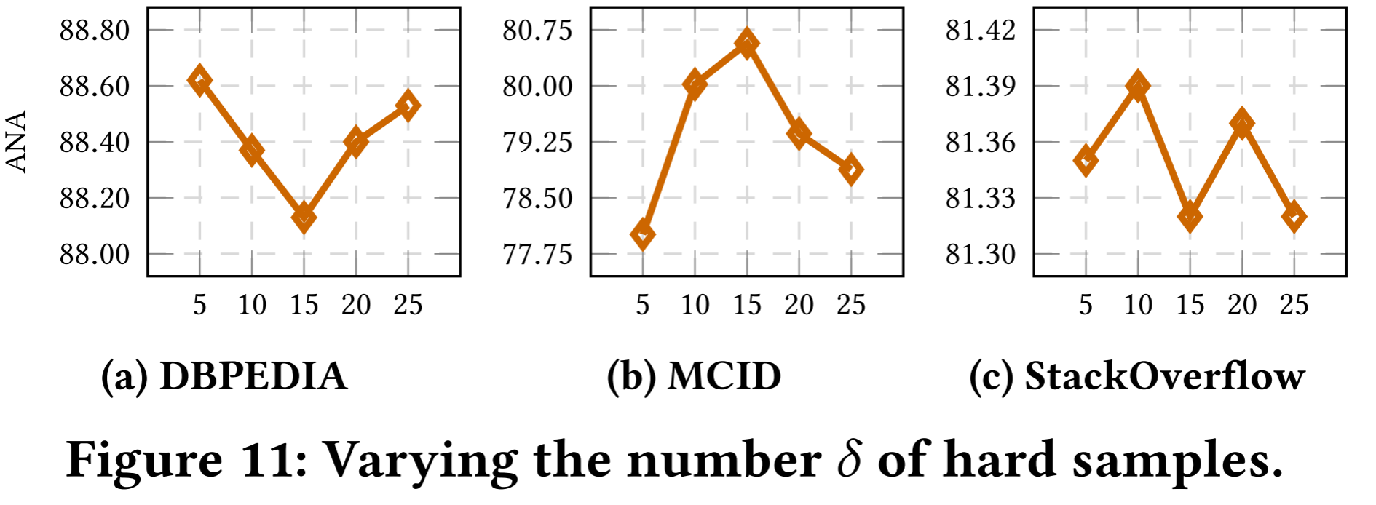
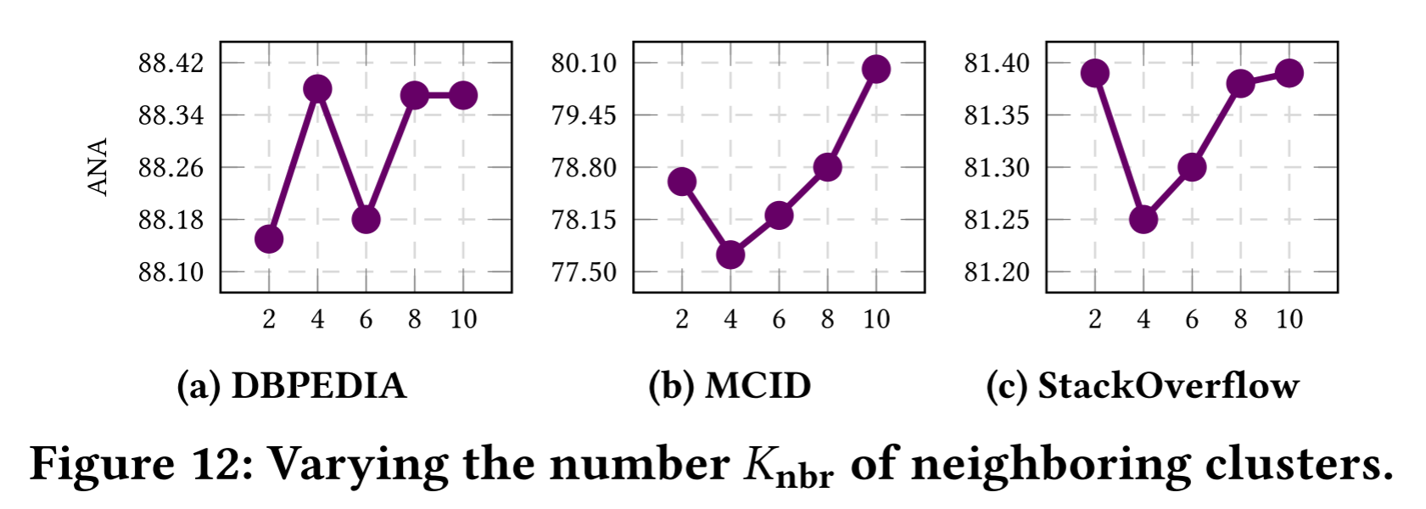
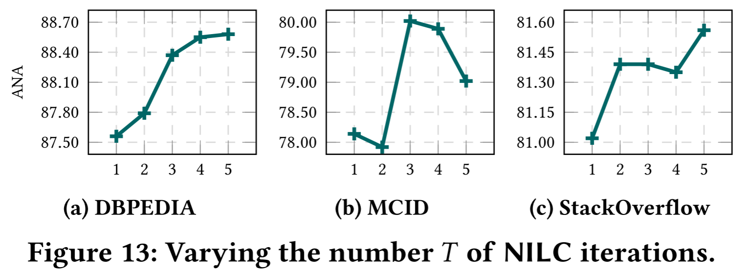
ATAI
AdvancedTechniqueof
Artificial Intelligence
ATAI
ChongqingUniversity _{AdvancedTechniqueof}
of Technology Artificial Intelligence
ChongqingUniversity of Technology
Experiments

Slide 13
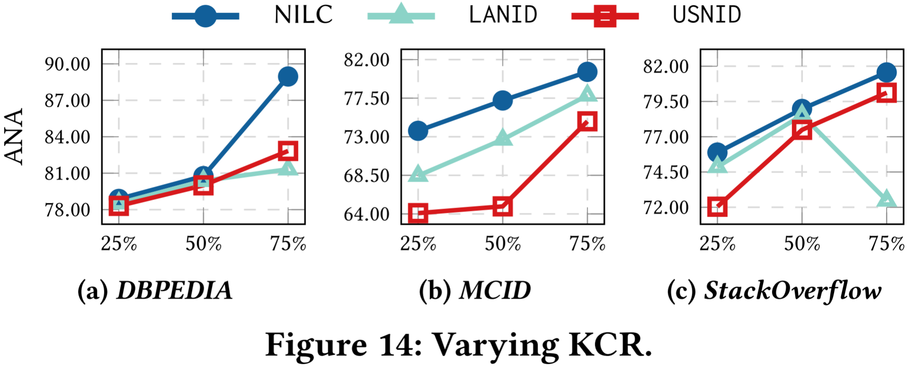
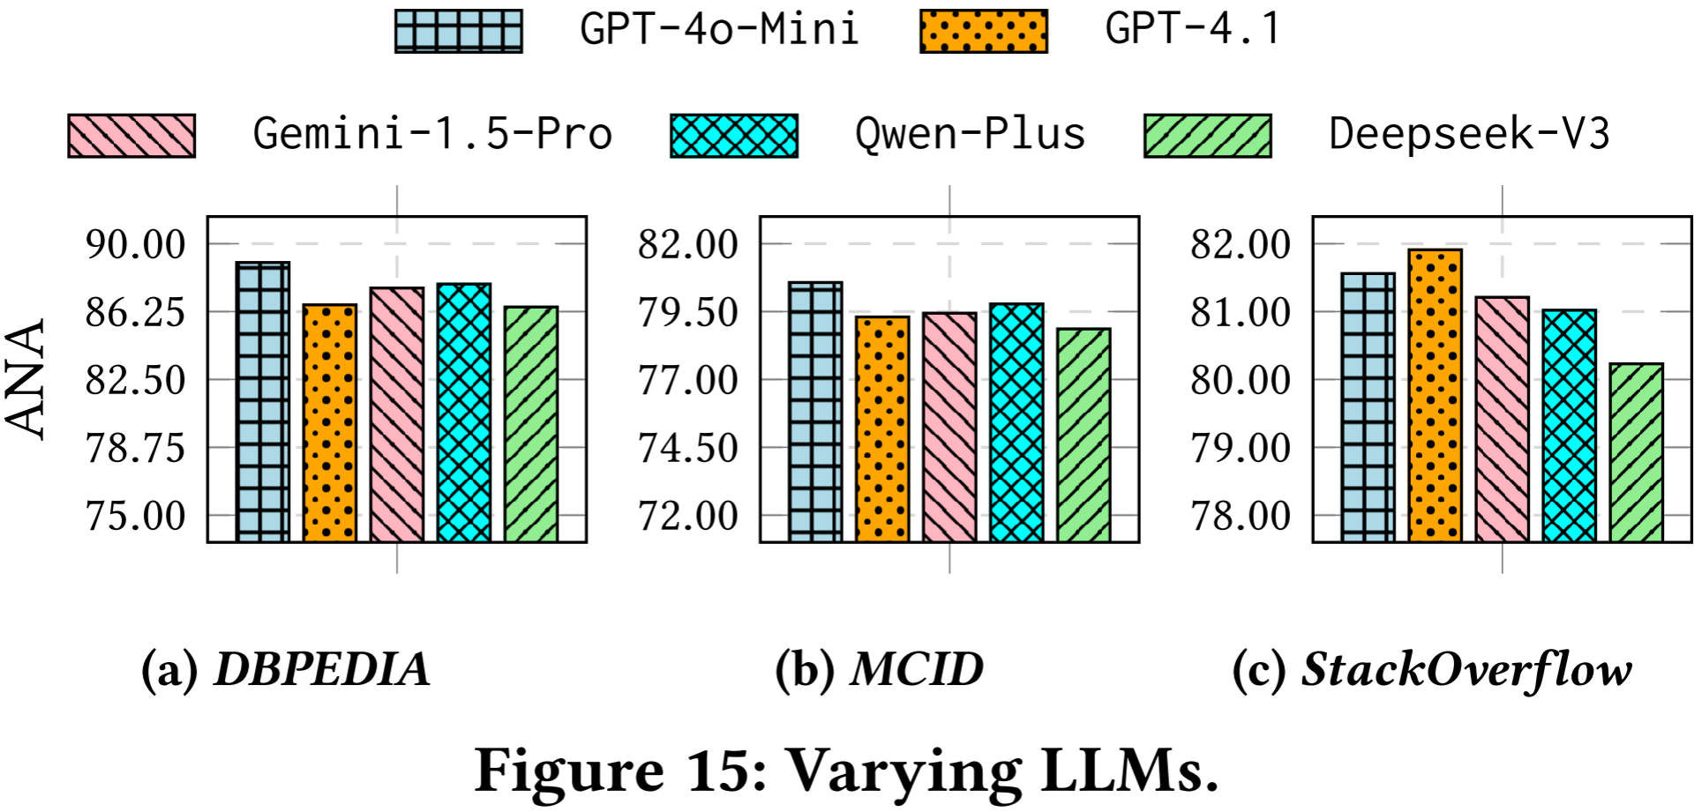
ATAI
AdvancedTechniqueof
Artificial Intelligence
ATAI
ChongqingUniversity _{AdvancedTechniqueof}
of Technology Artificial Intelligence
ChongqingUniversity of Technology
Experiments

Slide 14


ChongqingUniversity of Technology
ATAI
AdvancedTechniqueof
Artificial Intelligence
ATAI
ChongqingUniversity _{AdvancedTechniqueof}
of Technology Artificial Intelligence
Thanks!

